Slide 1
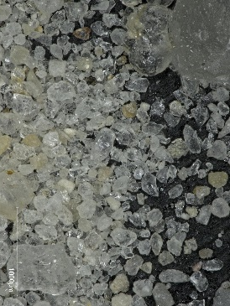
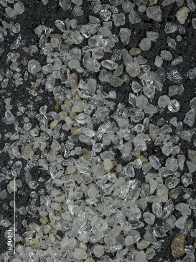
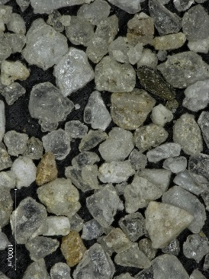
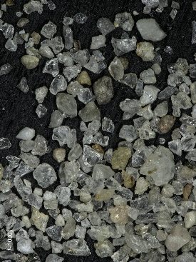
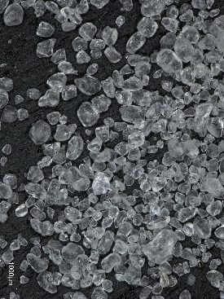
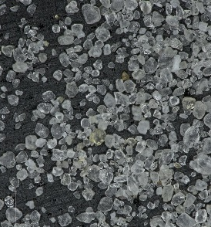
Material | Particle Size and Distributionᶧ, mm |  |  |  | USCS | Particle Shape | Microscope Image (same scale, ~2.5mm wide) | Bulk Densityᶧᶧ, g/cc |  | Friction Angleᶧᶧ |  | Past Use and Mobility Notes | Advantages/Disadvantages | Sourcing
 | D₁₀ | D₃₀ | D₆₀ | C_{u} |  |  |  | min | max | min | 30% rel. density
GRC-1 | 0.094 | 0.160 | 0.390 | 4.15 | SP (poorly graded sand, little fines) | sub angular |  | 1.55 | 1.70 | 34 | 38 |  |  | Black Lab Corps, Chardon OH, lead time 1 wk + ship
Best Sands 110 | 0.049 | 0.053 | 0.079 | 1.61 | SP-SM (poorly graded sand-silt mixture) | sub angular |  | 1.29 | 1.44 | 31 | 33 |  | Finest material on list | Black Lab Corps, Chardon OH, lead time <1 wk + ship
Minus 30 | 0.130 | 0.160 | 0.190 | 1.46 | SP (poorly graded sand, little fines) | sub angular |  | 1.35 | 1.52 | 29 | 36 |  |  | Soils Direct, Sunland CA, lead time <1 wk + ship
#90 | 0.070 | 0.093 | 0.130 | 1.95 | SP (poorly graded sand, little fines) | sub angular |  | 1.32 | 1.52 | 29 | 37 | N/A |  | Soils Direct, Sunland CA, lead time <1 wk + ship
Wedron 730 | 0.080 | 0.100 | 0.140 | 1.75 | SP (poorly graded sand, little fines) | rounded |  | 1.49 | 1.63 | 27 | 32 | N/A | Rounded | Black Lab Corps, Chardon OH, lead time <1 wk + ship
BLC 110 | 0.053 | 0.075 | 0.093 | 1.75 | SP-SM (poorly graded sand-silt mixture) | rounded |  | 1.45 | 1.52 | 28 | 38 | N/A | Rounded | Black Lab Corps, Chardon OH, lead time <1 wk + ship
Lunar terrain strength analog specifically for mobility testing
Publication - H. Oravec, V. Asnani, and X. Zeng, "Design and Characterization of GRC-1: A Soil for Lunar Terramechanics Testing in Earth-Ambient Conditions," Journal of Terramechanics 2010
High bearing strength, low shear strength type response to wheeled systems
Widest range of particle size
Well characterized geotechnical and mobility response
Has been utilized for numerous research vehicle and wheel development programs
Vehicles tested quickly densified sand and able to generate much higher shear strength than GRC-1
Used/currently located in JPL Mars Yard loose slope for MSL development
Least expensive to source long term since no large distance shipment needed to Pasadena
Low expense to source long term since no large distance shipment needed to Pasadena
ᶧall size data from current manufacturer spec. sheets except for GRC-1 from H. Oravec (heather.a.oravec@nasa.gov) ᶧᶧall soils tested ASTM D 4253 density and ASTM D 3080 direct shear by California Testing and Inspections Laboratory

